Slide 1
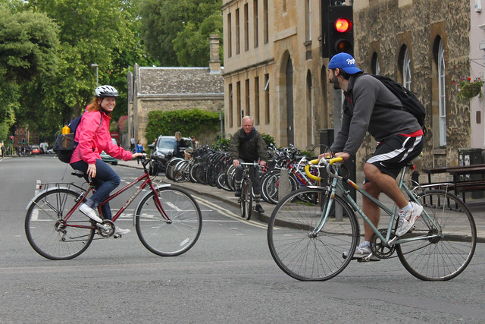

Input image to analyze
Prediction model f
Prediction
$$\hat{y}$$
Examples of different tasks (i.e. types of prediction) in Computer Vision:
Classification
Object detection
Segmentation
Captioning
…
traffic light
person
✓ Street
✘ Office
✘ Bedroom
✘ …
person
person
a girl in a pink jacket on a bicycle passes a man in a blue cap on a bicycle.
car
bike
bike
bike

Slide 2
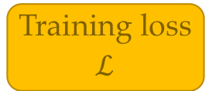
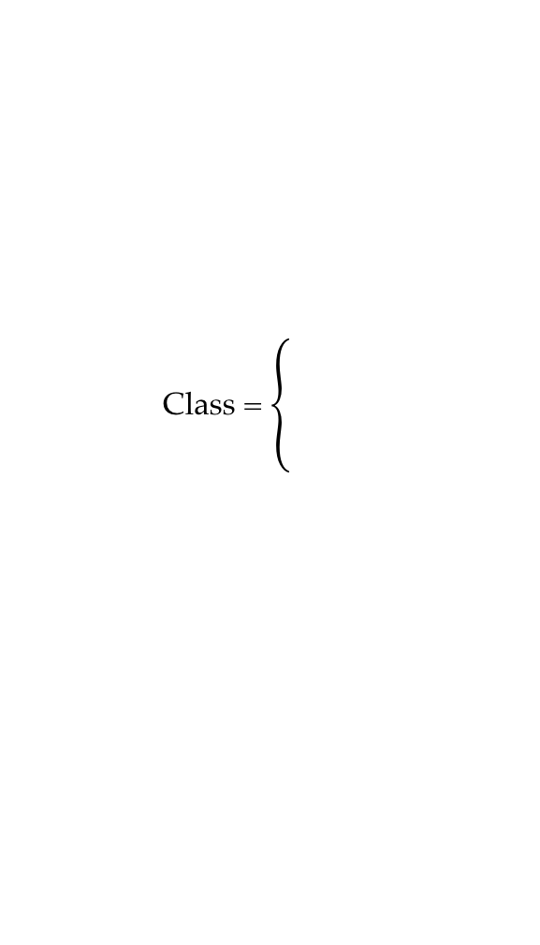
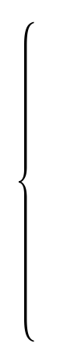

w
Optimization algorithm
Parameters
Prediction model
f
Prediction
Input image x
Training loss
$$ℒ$$
$$\hat{y}$$
Dataset of pairs
(x, y)
Class =
✓ Street
✘ Office
✘ …
Target
y
y

Slide 3
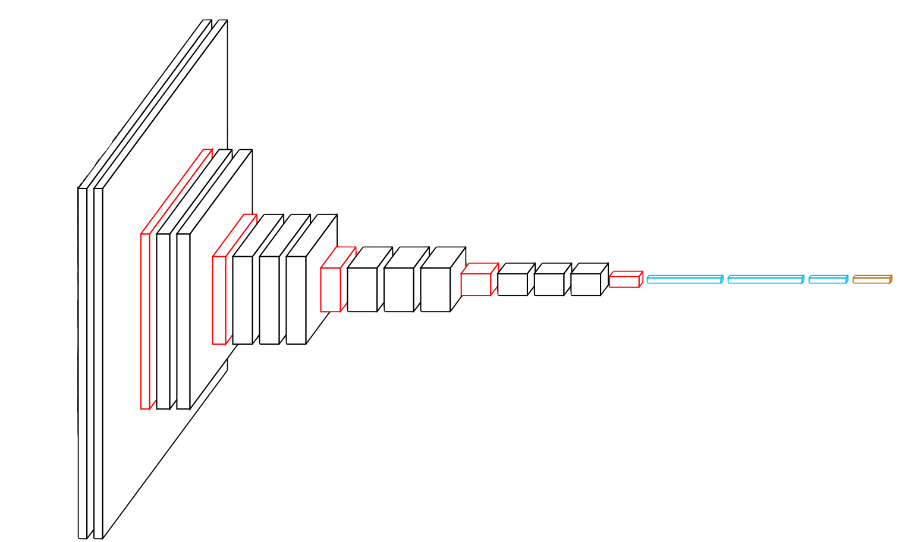
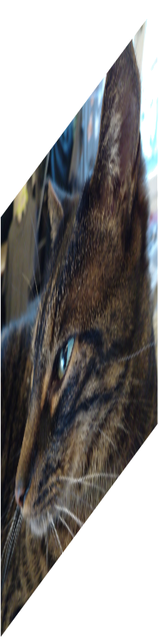

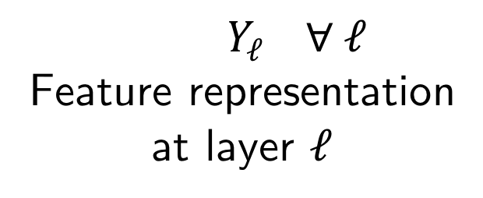
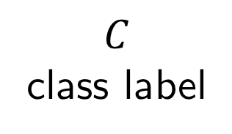
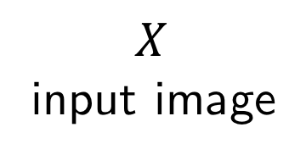
$$X$$ input image
$$Y_{ℓ} ∀ ℓ$$
Feature representation
at layer $ℓ$
$$C$$
class label
cat
$$w$$
Network parameters

Slide 4
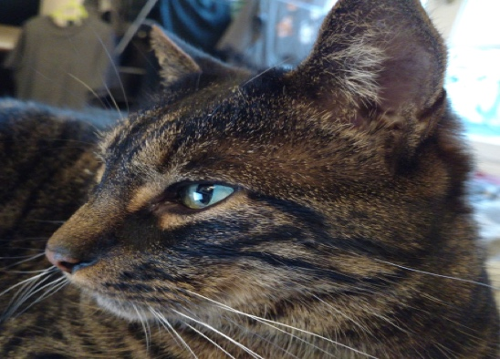
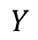
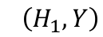
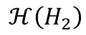
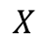
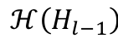
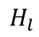
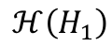
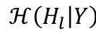
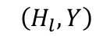
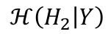
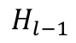
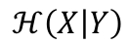

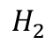
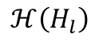
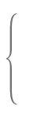
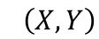

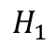
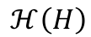
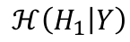
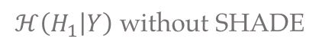
$$X$$
$$H_{1}$$
$$H_{2}$$
$$H_{l−1}$$
$$H_{l}$$
$$Y$$
…
$$ℋ\left(H\right)$$
$$ℋ\left(H_{1}\right)$$
$$ℋ\left(H_{2}\right)$$
…
$$ℋ\left(H_{l−1}\right)$$
$$ℋ\left(H_{l}\right)$$
$$I\left(X,Y\right)$$
$$I\left(H_{1},Y\right)$$
$$I\left(H_{2},Y\right)$$
»
$$I\left(H_{l},Y\right)$$
»
$$ℋ\left(H_{l} | Y\right)$$
$$ℋ\left(X | Y\right)$$
»
$$ℋ\left(H_{1} | Y\right)$$
»
$$ℋ\left(H_{2} | Y\right)$$
$ℋ\left(H_{1} | Y\right)$ without SHADE
»
Effect of SHADE: Reduction of conditional entropy

Slide 5
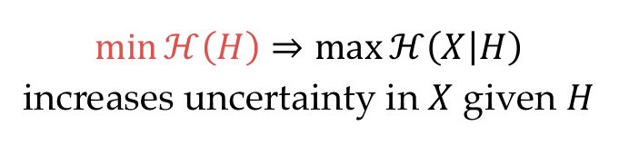
Input images
Feature representation
E
$$\min{ℋ\left(H\right)}⇒\max{ℋ\left(X | H\right)}$$
increases uncertainty in $X$ given $H$

Slide 6
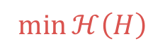
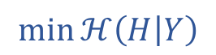
$$\min{ℋ\left(H | Y\right)}$$
cats
E
cars
$$\min{ℋ\left(H\right)}$$

Slide 7
bird
ŷ
x
W_{c}
x̂
+
W_{u}
HybridNet model

Slide 8

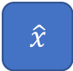
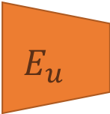

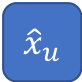


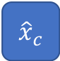
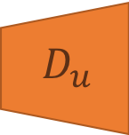
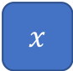
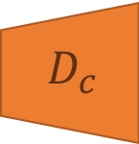
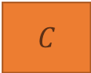
$$C$$
$$\hat{y}$$
$$E_{c}$$
$$D_{c}$$
$$h_{c}$$
$${\hat{x}}_{c}$$
$$x$$
$$\hat{x}$$
$$E_{u}$$
$$D_{u}$$
$$h_{u}$$
$${\hat{x}}_{u}$$

Slide 9
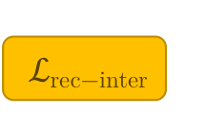

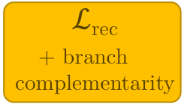
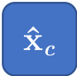
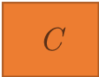
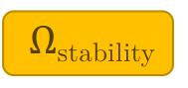
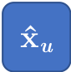
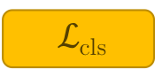


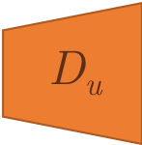
$$\text{C}$$
$$\text{y}\text{̂}$$
$ℒ\text{cls}$
E_{c}
D_{c}
$Ω\text{stability}$
h_{c}
$$\text{x}\text{̂}\text{c}$$
$$\text{x}$$
$$\text{x}\text{̂}$$
$ℒ$_{rec}
+ branch + complementarity
-
E_{u}
$$\text{D}\text{u}$$
h_{u}
$$\text{x}\text{̂}\text{u}$$
$ℒ\text{rec}\text{−}\text{inter}$
-

Slide 10
ŷ
x̂_{c}
E_{c}
D_{c}
h_{c}
x
x̂
x̂_{u}
E_{u}
D_{u}
h_{u}
Pooling switches

Slide 11
Input
Discr.
Unsup.
Rec.
Input
Discr.
Unsup.
Rec.
x
x̂_{c}
x̂_{u}
x̂
x
x̂_{c}
x̂_{u}
x̂
→
+
=
→
+
=
→
+
=
→
+
=
→
+
=
→
+
=
→
+
=
→
+
=
→
+
=
→
+
=

Slide 12
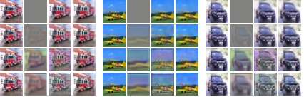

Final rec.
Model accuracy
Intermed. rec.
Complement.
Stability
Visualisations
x x̂_{c} x̂_{u} x̂ x x̂_{c} x̂_{u} x̂ x x̂_{c} x̂_{u} x̂
(1)
✓
72.4
74.0
75.2
81.6
(2)
✓
✓
(3)
✓
✓
✓
(4)
✓
✓
✓
✓
(1)
✓
72.4
74.0
75.2
81.6
(2)
✓
✓
(3)
✓
✓
✓
(4)
✓
✓
✓
✓

Slide 13



Input info.
Info. preserved in the encoding
AE
HybridNet
Discriminative
Classif. branch
Unsup. branch
→
Non-discriminative
x
h
h_{c}
h_{u}
Corresponding input data represented

Slide 14









$Ω_{SHADE}$
Discriminative encoder
Classifier
32×32×64
16×16×64
8×8×64
4×4×64
10
conv
max pool
conv
max pool
conv
max pool
$$h_{c}$$
fc
$$\hat{y}$$
$$ℒ_{cls}$$
Supervised
baseline
32×32×3
5×5
3×3
3×3
$$x$$
32×32×64
16×16×64
8×8×64
4×4×64
4×4×64
8×8×64
16×16×64
32×32×3
32×32×3
conv
max pool
conv
max pool
conv
max pool
$$h_{u}$$
$$h$$
upscale
conv
upscale
conv
upscale
conv
$$\hat{x}$$
$$ℒ_{rec}$$
SWWAE
+
5×5
3×3
3×3
3×3
3×3
5×5
Unsupervised encoder
Decoder

Slide 15

Latent representations of
information domains
id 3
Identity h_{y}
id 4
id 1
id 2
Enc.
female
Dec.
$$\hat{x}$$
x
no glasses
glasses
Female, blonde,
smiling…
male
Attributes h_{z}
Female, brown hair,
bangs, smiling…
…
Male, black hair,
not smiling…
Male, black hair,
glasses, beard…
Disentangling
D( , ) =
D( , ) =
D( , ) =
Image editing
D( , ) =
D( , ) =
D( , ) =
D( , ) =
D( , ) =
D( , ) =

Slide 16















Baselines
Architecture
Training
HybridNet
UAI
MTAN
Multi-task
Adv. on y
Ours
Adv. classifiers
Main loss
Discr. loss
Identity branch
C_{z}
$${\hat{z}}_{adv}$$
$$ℒ_{adv,z}$$
E_{y}
h_{y}
W_{y}
$$\hat{y}$$
$$ℒ_{disc,z}$$
U
$$ℒ_{y}$$
U
x
E
h
D
$$\hat{x}$$
$$ℒ_{rec}$$
Attributes branch
$$ℒ_{z}$$
E_{z}
h_{z}
W_{z}
$$\hat{z}$$
$$ℒ_{disc,y}$$
C_{y}
$${\hat{y}}_{adv}$$
$$ℒ_{adv,y}$$
U
U
Loss propagated to
Active
E…
C
Active in UAI variant (C_{y/z} replaced by U_{y/z})
U

Slide 17
Input
remove
Attribute modification strength
0
add
Female / Male
Eyeglasses
Heavy Makeup
Smiling
Beard
Bangs
Blond Hair
Brown Hair

Slide 18
Input
Reconstr.
w/o modif.
- attribute removed + attribute added
Female / Male
Eyeglasses
Heavy Makeup
Smiling
Beard
Bangs
Blond Hair
Brown Hair

Slide 19


Initial images. x^{(id)} : Identity source / x^{(attr)} : Attribute source
x^{(id)}
x^{(attr)}
DualDis
Baseline
without z
Generations from $\left(h_{y}^{\left(id\right)},h_{z}^{\left(attr\right)}\right)$ produced by DualDis and the baseline

Slide 20
Input
Rec.
Light sources

Slide 21
Input
Camera elevation
Factor changed
Camera angle
Light variations

Slide 22
Azimuth
-95
-35
-20
20
35
95
80
 | 1 | 2 | 3
4 | 5 | 6 | 7 | 8
9 | 10 | 11 | 12 | 13
20
Elevation
-20
-80
Outside: 0 (back light)

Slide 23


















HybridNet-like
No z labels
UAI predictor of opposite latent space
Adv. classifiers / predictor
Enc./dec. loss
Discr. loss
MTAN
Ours
UAI
U_{z}
$\hat{h}$_{z}
$$ℒ_{UAI,adv,z}$$
$$ℒ_{UAI,disc,z}$$
C_{z}
$${\hat{z}}_{adv}$$
$$ℒ_{adv,z}$$
Identity
branch
E_{y}
h_{y}
W_{y}
$$\hat{y}$$
$$ℒ_{disc,z}$$
$$ℒ_{y}$$
x
E
z
h
D
$$\hat{x}$$
$$ℒ_{rec}$$
OR
Attr.
branch
$$ℒ_{z}$$
E_{z}
h_{z}
W_{z}
$$\hat{z}$$
$$ℒ_{disc,y}$$
C_{y}
$${\hat{y}}_{adv}$$
$$ℒ_{adv,y}$$
U_{y}
$\hat{h}$_{z}
$$ℒ_{UAI,disc,y}$$
Optional replacement of h_{z} by z as input of D
Optional gradient blocking
for models without z labels
$$ℒ_{UAI,adv,y}$$
Used as part of the model
Trained to obtain metric (accuracy or disentangling) has no impact on the model
For “HybridNet-like + attr” and “UAI + attr”, simply remove the gradient blocking before W_{z}

Slide 24

Input
Input
Reconstr.
Back right
Right
Center
Left
Back left
(b) Attribute (camera position and lightning) editing on NORB
(a) Attribute (lightning source) editing on Yale

Slide 25









$E$
$D$
$x$
$Θ_{h}$
$h$
$$\hat{x}$$
$$ℒ$$
$ε$
$$D_{KL}\left(q\left(h | x\right) ‖ 𝒩\left(0,I\right)\right)$$

Slide 26









Dataset
$$x^{∗} \sim p_{data}\left(x\right)$$
$$x^{∗}$$
Real
Discrim.
$$D$$
1
or
$$ℒ$$
0
$$ε$$
Generator
$$G$$
$\tilde{x}$
Fake
$$ε \sim 𝒩\left(0,I\right)$$
$$\tilde{x} \sim p_{G}\left(x | ε\right)$$

Slide 27
LeNet-5
1998
Convolution
MaxPool
AvgPool
Concat
Dropout
Fully connected
Softmax
Residual add
AlexNet
2012
VGG-16
2015
2x
5x
2x
Inception V1
2015
2x
3x
5x
Inception V3
2016
3x
8x
36x
3x
ResNet-152
2016

Slide 28












$$C$$
$$\hat{y}$$
$$E_{c}$$
$$D_{c}$$
$$h_{c}$$
$${\hat{x}}_{c}$$
$$x$$
$$\hat{x}$$
$$E_{u}$$
$$D_{u}$$
$$h_{u}$$
$${\hat{x}}_{u}$$

Slide 29








$$C$$
$$\hat{y}$$
$$E_{c}$$
$$h_{c}$$
$$h$$
$$D$$
$$x$$
$$\hat{x}$$
$$E_{u}$$
$$h_{u}$$

Slide 30
ŷ
Original classifier
x̂_{c}
E_{c}
D_{c}
h_{c}
x
x̂
x̂_{u}
E_{u}
D_{u}
h_{u}
Pooling switches
Convolution
Max Pooling
Upsampling / Unpooling

Slide 31

id 3
id 4
Identity h_{y}
id 1
id 2
Decoder
Encoder
female
$$\hat{x}$$
x
no glasses
glasses
Female, blonde,
smiling…
male
Attributes h_{z}
Female, brown hair,
bangs, smiling…
Male, black hair,
not smiling…
…
Male, black hair,
glasses, beard…

Slide 32
D( , ) =
D( , ) =
D( , ) =

Slide 33
D( , ) =
D( , ) =
D( , ) =
D( , ) =
D( , ) =
D( , ) =

Slide 34









































Discrim. branch reconstr.
$${\hat{x}}_{c}$$
Unsup. branch reconstr.
$${\hat{x}}_{u}$$
Discrim. branch reconstr.
$${\hat{x}}_{c}$$
Unsup. branch reconstr.
$${\hat{x}}_{u}$$
Final
reconstr.
$$\hat{x}$$
Original
input
$$x$$
Final
reconstr.
$$\hat{x}$$
Original
input
$$x$$
No
stability
&
$$→$$
No
stability
&
$$→$$
SHADE
stability
&
$$→$$
SHADE
stability
&
$$→$$
No
stability
&
$$→$$
No
stability
&
$$→$$
SHADE
stability
&
$$→$$
SHADE
stability
&
$$→$$

Slide 35






Without branch balancing
With branch balancing
0.75
$${\left\|x−{\hat{x}}_{c}\right\|}_{2}^{2}$$
0.75
$${\left\|x−{\hat{x}}_{c}\right\|}_{2}^{2}$$
$${\left\|x−{\hat{x}}_{u}\right\|}_{2}^{2}$$
$${\left\|x−{\hat{x}}_{u}\right\|}_{2}^{2}$$
0.5
$${\left\|x−\hat{x}\right\|}_{2}^{2}$$
0.5
$${\left\|x−\hat{x}\right\|}_{2}^{2}$$
Loss value
0.25
0.25
0
0
0
10
20
30
40
0
10
20
30
40
Epochs
Epochs

Slide 36






















Without branch balancing
With branch balancing
$$C$$
$$\hat{y}$$
$$C$$
$$\hat{y}$$
$$E_{c}$$
$$D_{c}$$
$$E_{c}$$
$$D_{c}$$
$$h_{c}$$
$$h_{c}$$
+
+
$$E_{u}$$
$$D_{u}$$
$$E_{u}$$
$$D_{u}$$
$$h_{u}$$
$$h_{u}$$

Slide 37






Prior distribution $p(h)$
Distribution of realistic face representations
$$h=E\left(x\right)$$
$$G(h,z)$$
Distribution of faces for a given attribute vector $z$
$$G(\tilde{h},z)$$
$$\tilde{h} \sim p(h)$$

Slide 38





Entangled manifold of input data
Illustrative view of the image manifold
Disentangled representation space
Schematic view of independent factors
Glasses
Makeup
Disentangling model
Hat
Mustache
Smiling
…

